Slide 1
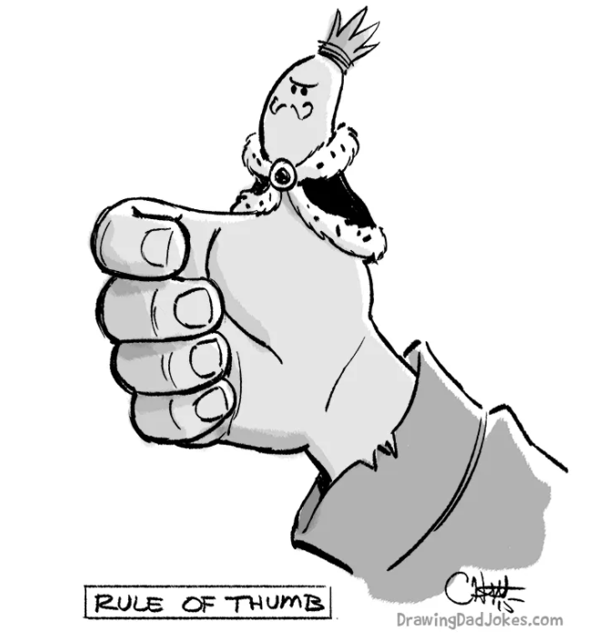
6MMCS001W Mobile User Experience Lecture
Mobile design principles ● Placement & interaction style

Slide 2
Placement & interaction style

Slide 3
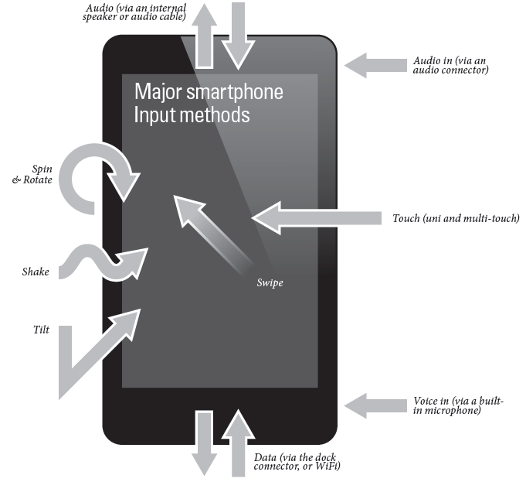
Basic design principle
Key factors that determine the design of a mobile app is the way of interacting with a mobile device in terms of:
device ergonomics &
Input
device keys?
touchscreen?

Slide 4
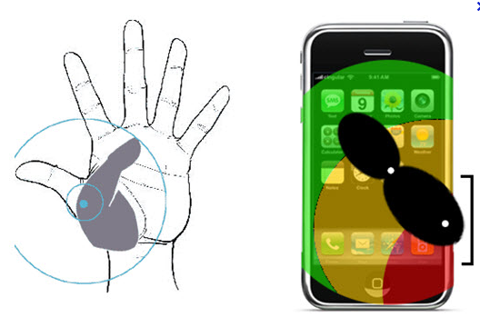
What determines the design of an app
Ergonomics

Slide 5
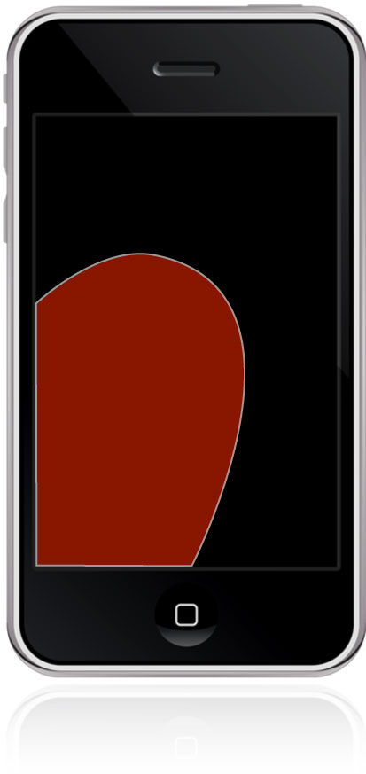
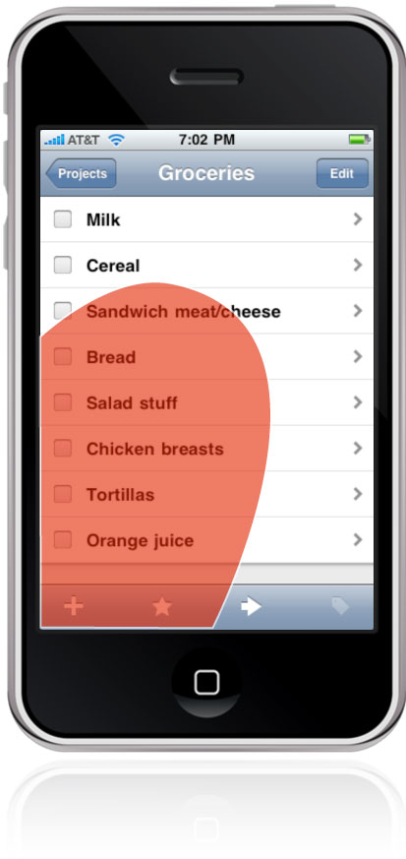
What determines the design of an app
Ergonomics –
Rule of Thumb
Let your thumb point the way in laying out your screens according to the most use cases for your apps
“Place primary tap targets in this thumb-thumping hot zone
When holding a phone in the right hand, for example, the thumb falls naturally in an arc at the bottom left corner of the screen. That's an important reason why toolbars and navigation typically land at the bottom edge of phone interfaces – the opposite of what we're accustomed to for traditional screen interfaces. ”
“Frequently used buttons should occupy the bottom of the screen for easy tapping, while other controls should be nudged out of harm's way. It's a convention in iOS, for example, to place Edit buttons at the top right, within easy view but just enough out of reach to make accidental changes less likely.”
Josh Clark, .net, February 01, 2012
http://www.netmagazine.com/features/designing-touch

Slide 6
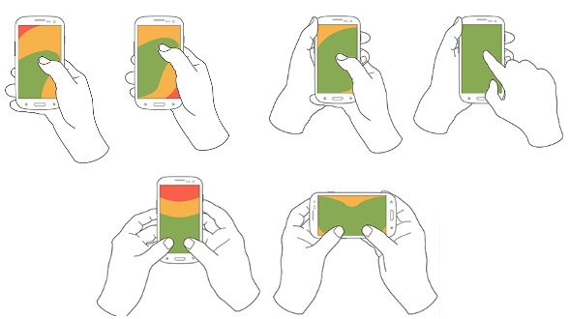
What determines the design of an app
Thumb zone

Slide 7
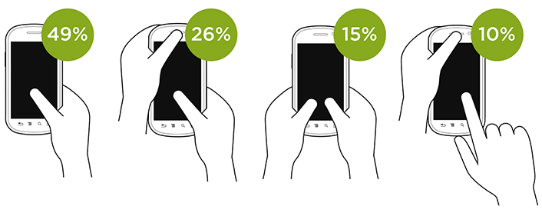
What determines the design of an app
Smartphone posture

Slide 8

What determines the design of an app
Ergonomics
The ergonomics of mobile phones are radically different from those of tablets
They have different reach pattern
As tablets increase in size the usage pattern changes
The most commonly used parts of the UI should be reachable with the thumbs within this zone of the screen

Slide 9
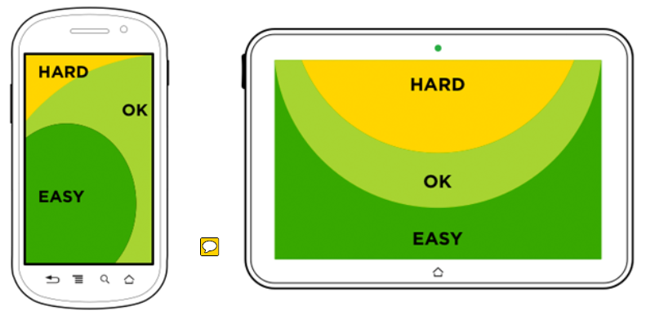
Touch Zone Guidelines

Slide 10
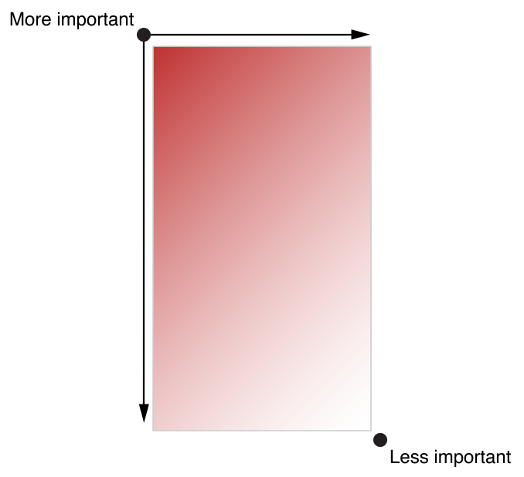
Use the layout to communicate
Layout encompasses:
how UI elements look on an app screen
directs the users to see:
what is most important
what their choices are
how things are related:
e.g. large items catch the eye and tend to appear more important than smaller ones
alignment can be used to ease scanning and communicate groupings or hierarchy (Gestalt principles)

Slide 11
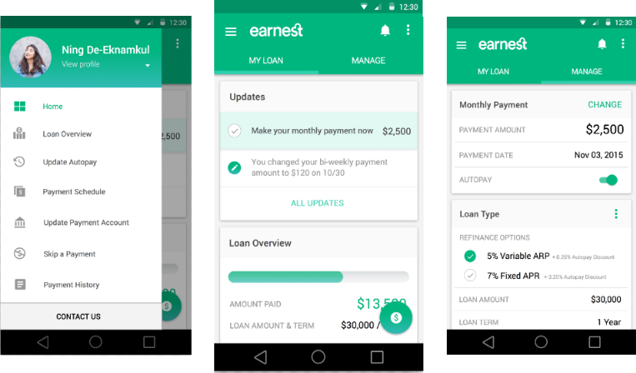
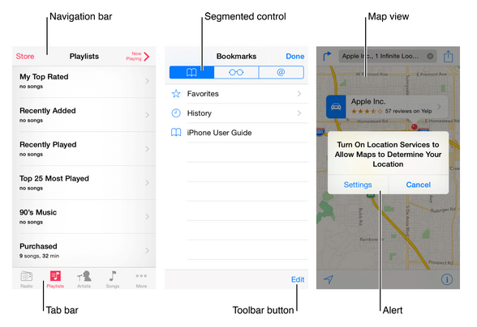
Mobile UI Anatomy
The UI elements provided by UIKit fall into four broad categories:
Bars. Bars contain contextual information that tells users where they are and controls that help users navigate or initiate actions.
Content views. Content views contain app-specific content and can enable behaviours such as scrolling, insertion, deletion, and rearrangement of items.
Controls. Controls perform actions or display information.
Temporary views. Temporary views appear briefly to give users important information or additional choices and functionality.

Slide 12
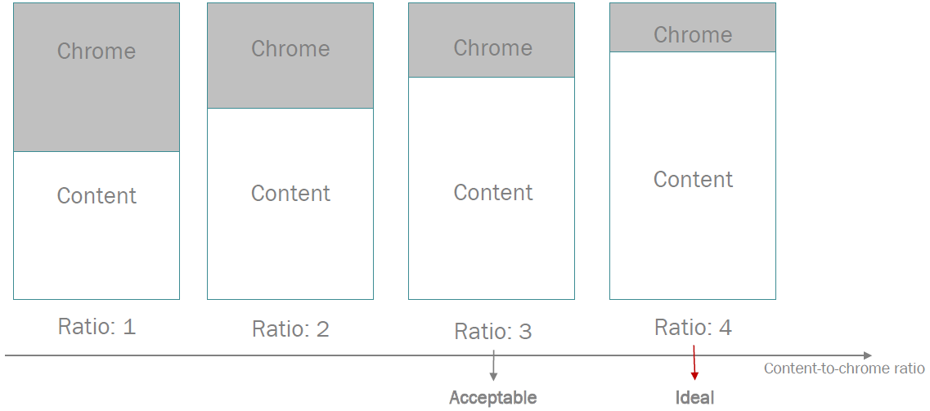
Chrome-content ratio

Slide 13
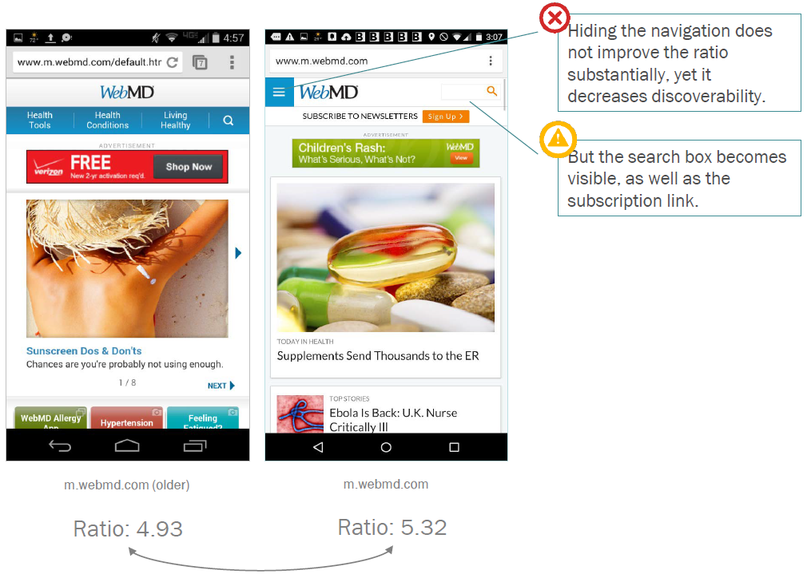
Chrome-content ratio

Slide 14

Fold

Slide 15
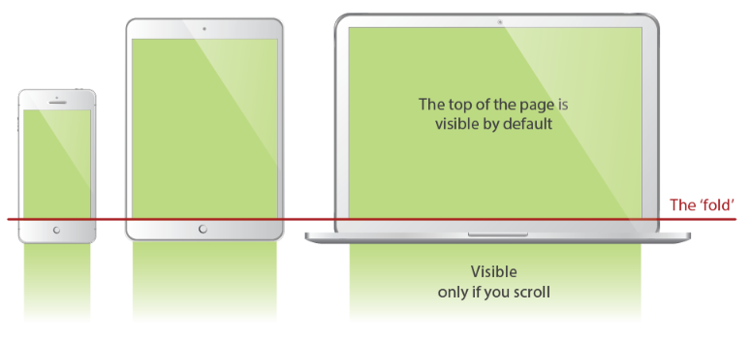
The fold on UI design

Slide 16
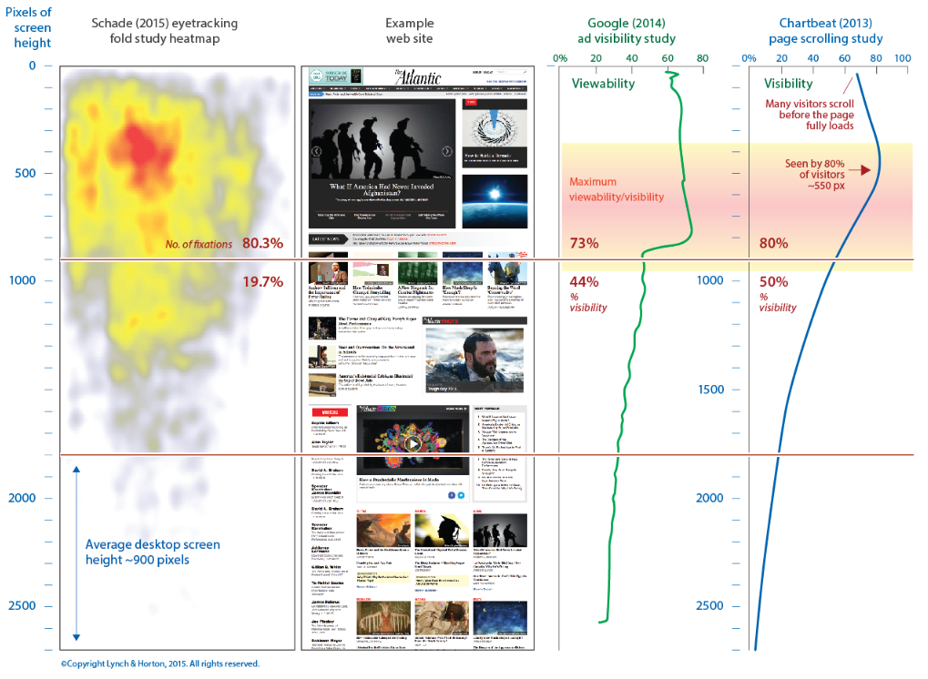
Why the fold matters
https://coastfieldguides.com/2015/02/03/scrolling-and-the-fold-in-page-design/

Slide 17
Mini-IAs

Slide 18
Make content findable & accessible
1
2
3
4
5
6
7
8
9
Mini-IA:
Findability
Tells users what the page contains (i.e., if the information patch is worth their attention).
Accessibility
Gives users direct access to a section of interest.
Mental model
Understand what the site is about and how it is organized.
1 | 2 | 3
4 | 5 | 6
7 | 8 | 9

Slide 19
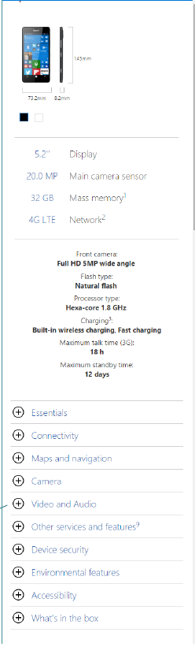
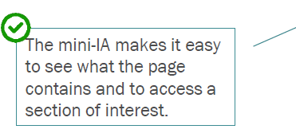
Mini-IAs – mental model

Slide 20
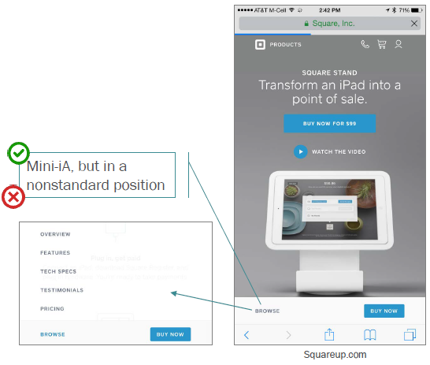
Mini-IAs - browse

Slide 21
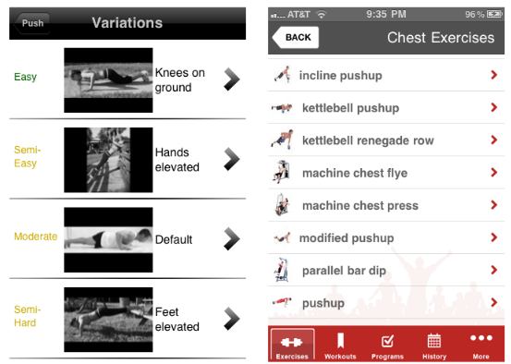
Mini-IAs – relevant structure

Slide 22
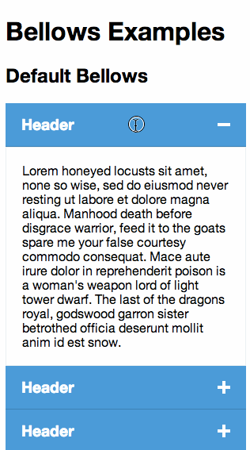
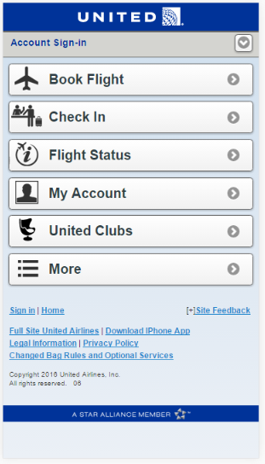
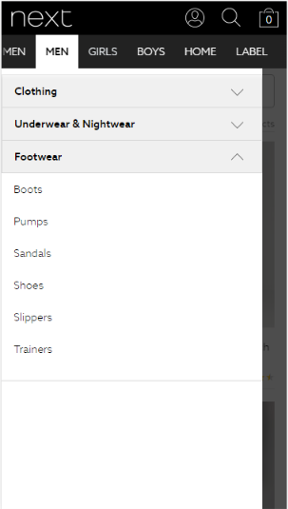
Mini-IAs – accordions

Slide 23

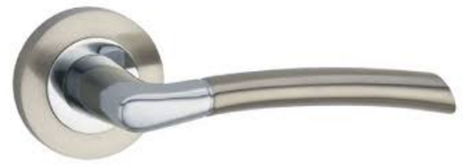
Signifiers
Interactivity
Scrolling, swiping
Providing visual feedback
Indicate affordance

Slide 24
4 basic tools
Colour
Symbols
Depth
Placement

Slide 25
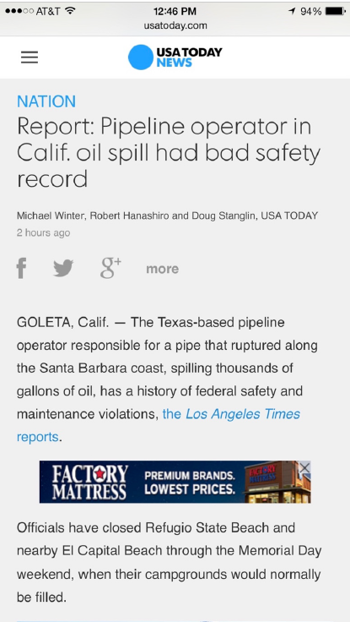
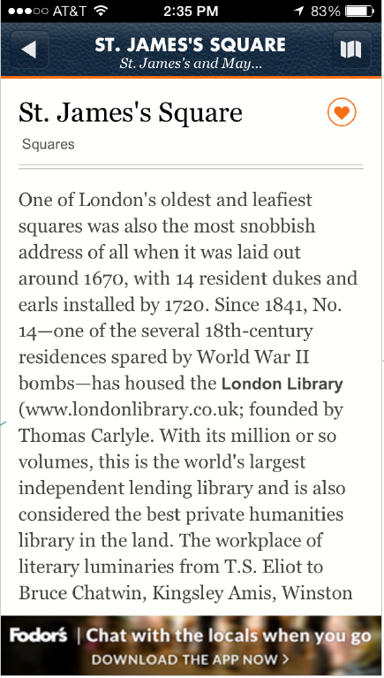
links
Links must stand out from the body copy through:
colour
placement
font treatment (underline, bold, and so on)

Slide 26
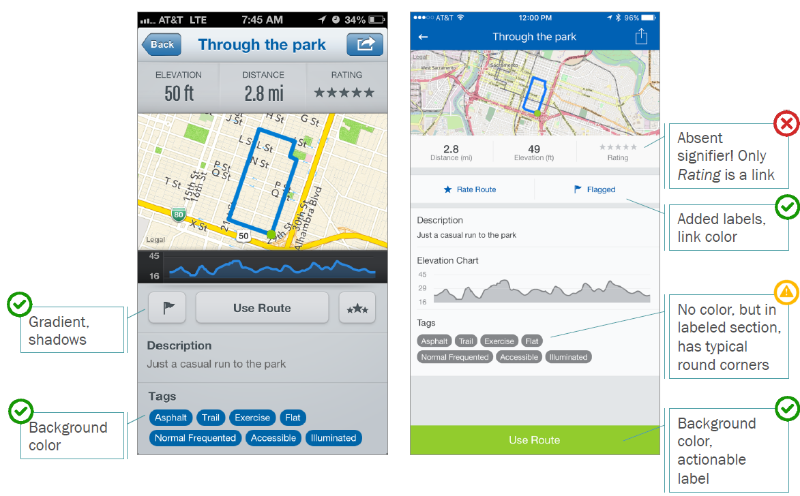
Buttons
Background colour
border
3-dimensional
actionable label
context: placement on the screen, surrounding elements
Use placement, colour, and size to add visual weight and direct attention

Slide 27
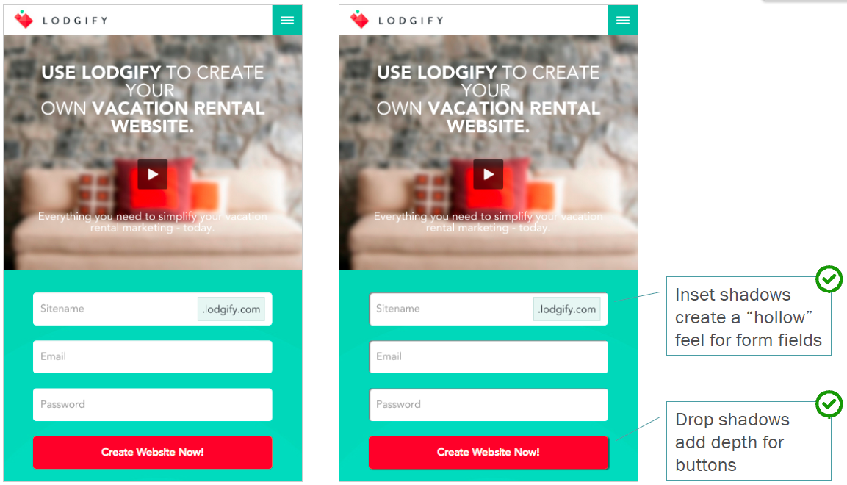
Utilize semi-flat styles

Slide 28
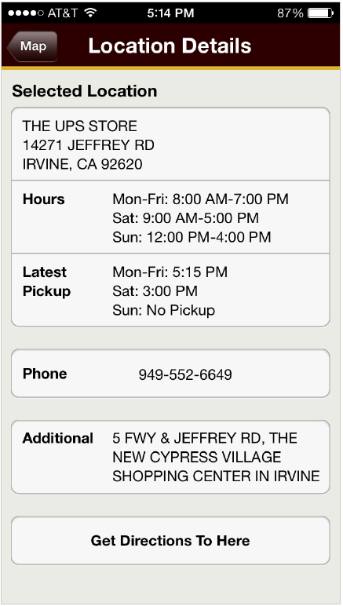
Which items are tapable?

Slide 29
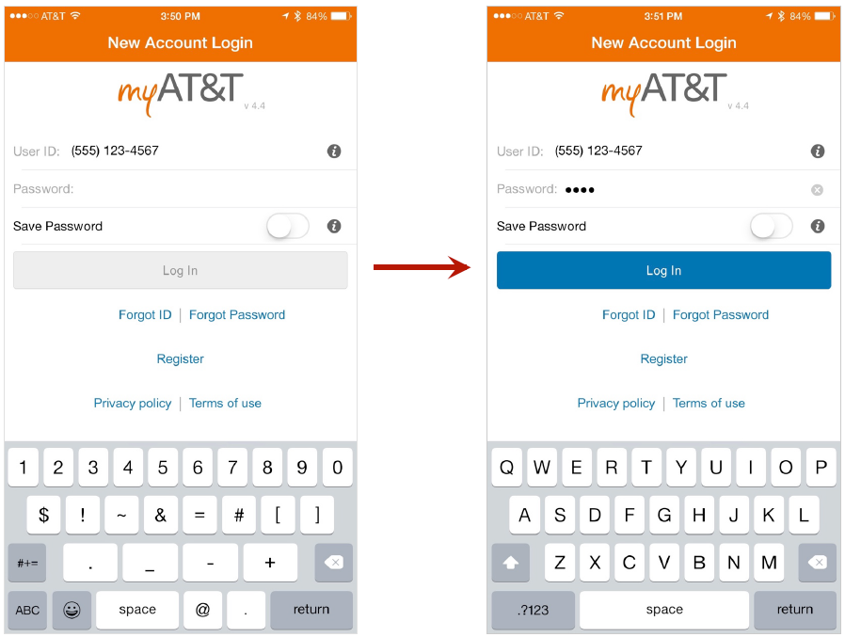
Which is active?

Slide 30
Gestures - swipe
Users must be given strong signifiers for horizontal navigation, as it is less common than scrolling vertically
“Peeking” or “bleeding” elements off the screen edges
faded edges, gradients
pagination controls

Slide 31
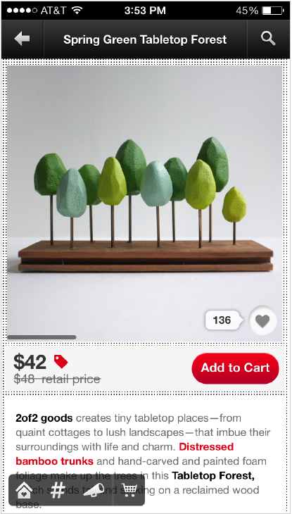
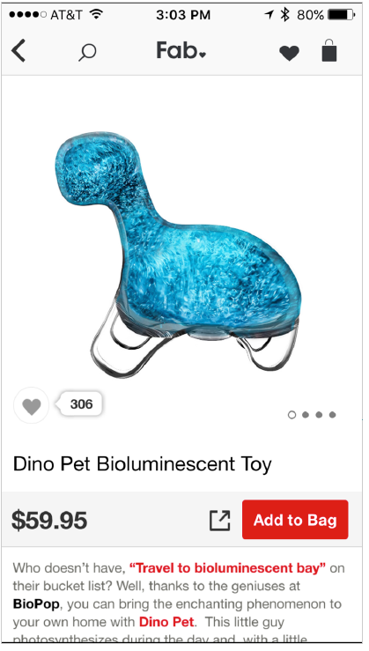
Gestures - swipe
Thin indicator bar only
appears once the user has already tried to swipe
Dot indicators are placed outside
the area for displaying the image

Slide 32
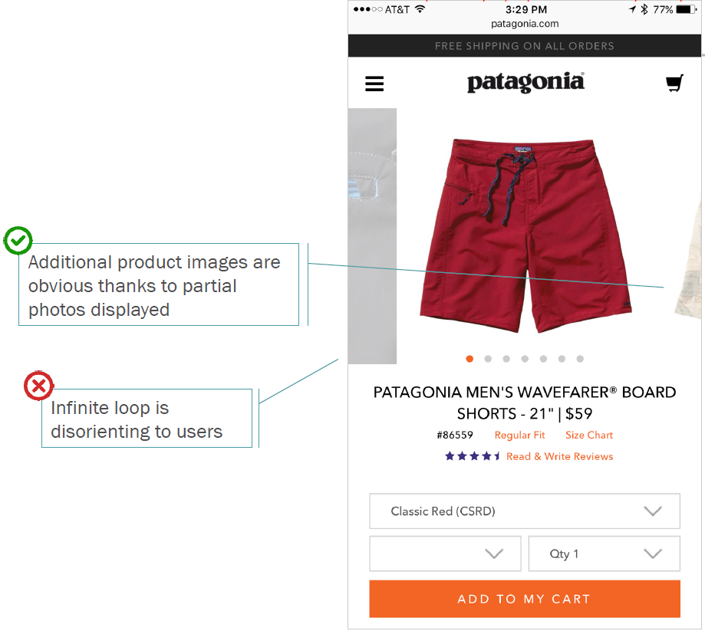
Gestures – swipe peeking elements

Slide 33
Gestures - scroll
Users will scroll as long as it is clear that additional, relevant information is “below the fold”
beware falsely signalling the end of content
avoid creating the “illusion of completeness”
minimize use of strong horizontal lines
be cautious of interruptions in the content flow

Slide 34
Touch targets
Mouse | Touch
Hover | Tap
Click

Slide 35

What determines the design of an app
Input –
touch
A great difference between PCs and mobile devices is direct manipulation with the touch
Multi-touch display – touch, gestures (it has been covered above), keyboard


Direct manipulation is a human–computer interaction style which involves continuous representation of objects of interest and rapid, reversible, and incremental actions & feedback. The intention is to allow a user to directly manipulate objects presented to them, using actions that correspond at least loosely to the physical world. An example of direct-manipulation is resizing a graphical shape, such as a rectangle, by dragging its corners or edges with a mouse.

Slide 36
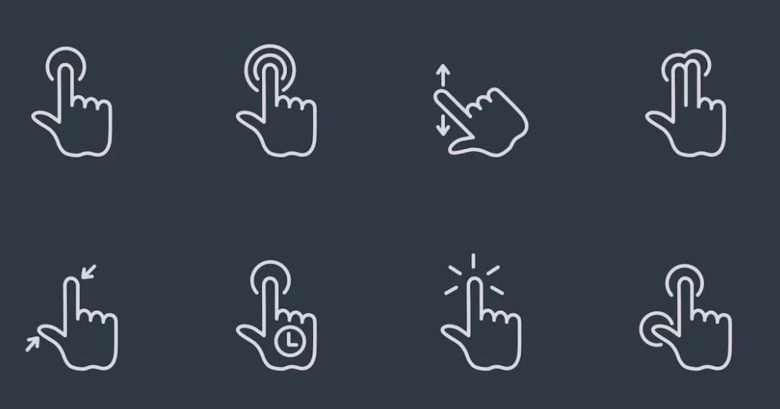

Interaction style
Touch Gesture Reference Guide

Slide 37
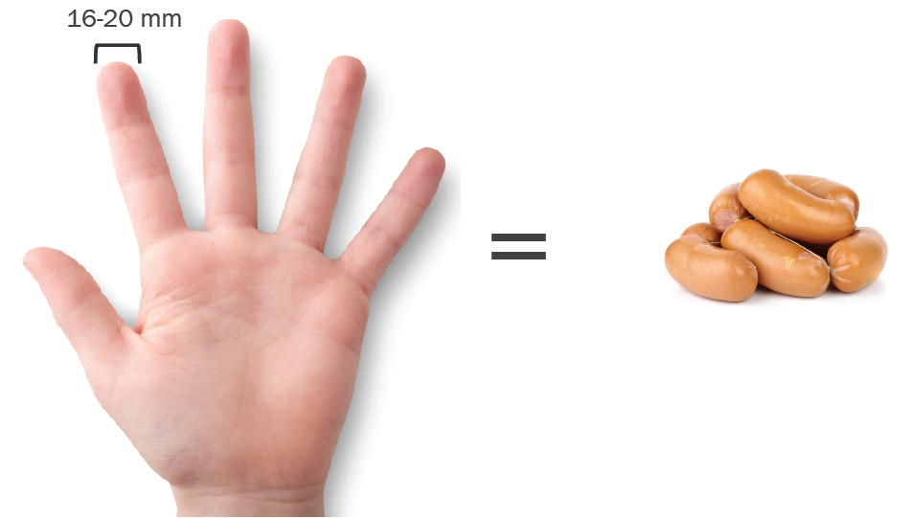
Better
Considerations
Bigger target size
Bigger text size
Padding
Spaced targets no crowding

